Slide 1
Customer Support Chat bot with ML
PIP2001 Capstone Project
Review-2
Batch Number: CAI-G05
Under the Supervision of,
Dr.Swati Sharma
Associate Professor - Selection Grade
School of Computer Science & Engineering
Presidency University
Roll Number | Student Name
20211CAI0065 20211CAI0147 20211CAI0175 20211CAI0076 20211CAI0064 | SIRI H G PAVAN S REDDY MOULYA H M E BHAVANI S SANJANA
Name of the Program: Bachelor of Technology
Name of the HoD: Dr. Zafar Ali Khan N
Name of the Program Project Coordinator: Dr. Afroz Pasha
Name of the School Project Coordinators: Dr. Sampath A K / Dr. Abdul Khadar A / Mr. Md Ziaur Rahman

Slide 2
Introduction
A very advanced solution for automating customer care is a Customer Support Chatbot with Machine Learning that can analyse client complaints or queries and actively learn from encounters.
This chatbot can evaluate consumer questions, look up possible answers in its database, and offer prompt support.
It easily moves the case to human support personnel when a novel or complicated problem emerges.
When the staff fixes the problem, the chatbot gains knowledge from the exchange, adds the updated solution to the database, and gets ready to answer similar questions in the future.
In addition to increasing response speed and accuracy, this technology guarantees ongoing learning and development, which gradually makes customer support more knowledgeable and flexible.

Slide 3
Literature Review
Improved intelligence: Chatbots are getting smarter, thanks to machine learning and NLP.
Better customer service: Chatbots can help customers quickly and efficiently.
Happy customers: Satisfied customers are more likely to stay loyal.
Personalized service: Chatbots can tailor their responses to each customer.
Deep learning: This technology helps chatbots understand language better.
Easy to use: Chatbots can be easily set up and managed.
Continuous learning: Chatbots get better over time by learning from interactions.

Slide 4
Literature Survey Contd..
KATRAGADDA, V. (2023): This paper likely provides an overview of chatbot automation in customer support, covering topics such as benefits, challenges, and best practices.
Patel, N., & Trivedi, S. (2020): This paper focuses on the use of predictive modeling, machine learning, NLP, and AI chatbots to enhance customer loyalty.
Nuruzzaman, M., & Hussain, O. K. (2018): This paper surveys the implementation of chatbots using deep neural networks in the customer service industry.
Nguyen, T. (2019): This paper explores the potential effects of chatbot technology on customer support, such as improved efficiency and reduced costs.
Abouelyazid, M. (2022): This paper delves into NLP techniques for automated customer support in e-commerce, specifically focusing on intent recognition and response generation.

Slide 5
Literature Survey Contd..
Iyambo, H. N., & Iyawa, G. (2023): This paper discusses the development of a customer support chatbot using machine learning techniques to enhance customer experience.
Suta, P., Lan, X., Wu, B., Mongkolnam, P., & Chan, J. H. (2020): This paper provides an overview of machine learning applications in chatbots, including topics such as natural language understanding, dialogue management, and knowledge representation.
Kumar, R., & Ali, M. M. (2020): This paper likely discusses the role of chatbots in customer support, potentially covering topics such as benefits, challenges, and case studies.
Kumar, N. K., Maheswari, K., Abinaya, A., Ramya, J., Ande, P. K., & Ramaian, C. P. (2024): This paper focuses on recent advancements in chatbot technology for enhanced customer support in online retail.
D'silva, G. M., Thakare, S., More, S., & Kuriakose, J. (2017): This paper describes a real-world smart chatbot for customer care implemented using a SaaS architecture.

Slide 6
Literature Survey Contd..
Numerous significant themes and potential avenues for future research can be discerned from the literature review:
A rise in chatbot sophistication can be seen in their increased ability to comprehend natural language, provide responses that seem human, and handle intricate client enquiries.
Integration with additional technologies: In order to deliver a more thorough customer experience, chatbots are being more and more integrated with additional technologies, including analytics software and CRM systems.
Ethical considerations: As chatbots proliferate, it's critical to take into account ethical concerns like privacy, bias, and transparency.
Progress in natural language processing (NLP) and machine learning: Chatbot performance will be enhanced by ongoing NLP and machine learning research and development.

Slide 7
Existing method Drawback
1. Rule-Based and Template-Based Chatbots: Limited to predefined responses, they struggle with complex or varied queries and lack learning capabilities, requiring manual updates.
2. Retrieval-Based Chatbots: Inaccurate when faced with ambiguous queries and incapable of learning from interactions without manual intervention.
3. Generative Chatbots: Inconsistent response quality, high dependency on large datasets, and difficulty in identifying when to hand off to human support.
4. Limited Hand-Off Capabilities: Inefficient in escalating issues and lacking feedback mechanisms to learn from human-agent interactions.

Slide 8
Proposed Method
Regardless of complexity or language, the suggested customer care chatbot employs Natural Language Processing (NLP) and Machine Learning (ML) to reliably interpret customer complaints or inquiries.
When pertinent answers are found, it searches a dynamic database and provides them instantly.
The chatbot ensures smooth handoffs by elevating questions to human support workers if they can't be answered by current knowledge.
The chatbot picks up knowledge from the resolution process during the staff-customer interaction and incorporates the updated solution into its database.
The chatbot can now respond to similar queries on its own in the future thanks to this ongoing learning process.
It lowers the need for manual updates and raises client satisfaction levels overall by getting better with every contact.
The chatbot also guarantees flexibility to meet changing client needs, optimizes response times, and offers round-the-clock assistance.

Slide 9
Objectives
Automate Responses: Without the need for human assistance, use AI to rapidly comprehend and respond to consumer inquiries.
Quick Solution Lookups: To get solutions right away, search the database (TSV file) for answers.
Escalate Complex Issues: When a bot is unable to assist, it forwards the problem to a human support representative.
Learn and Grow: As a result of interactions, the bot refreshes its memory to better address related queries in the future.
Boost Customer Satisfaction: To make the customer experience better, respond promptly.
Boost Productivity: Release human agents from mundane inquiries to enable them to concentrate on more complex problems.
Organize More Queries: Expand the chatbot's capacity to handle a larger volume of inquiries without sacrificing accuracy.
Provide round the clock Support: Make certain that clients may obtain assistance day or night.
Include User Input: Utilize user input to gradually improve the bot's intelligence.
Promote Business Growth: By lowering expenses and enhancing services, you can promote business growth.

Slide 10

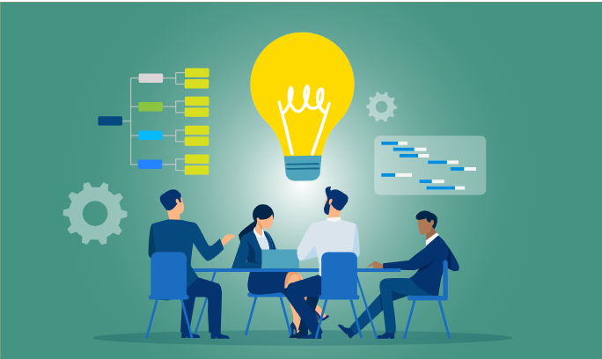

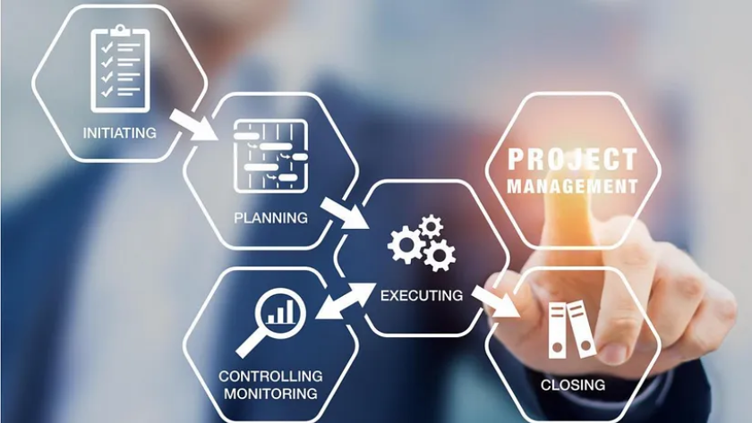

Methodology/Modules
1. Project Planning
2. Design
3. Development
4. Training and Testing
5. Deployment

Slide 11
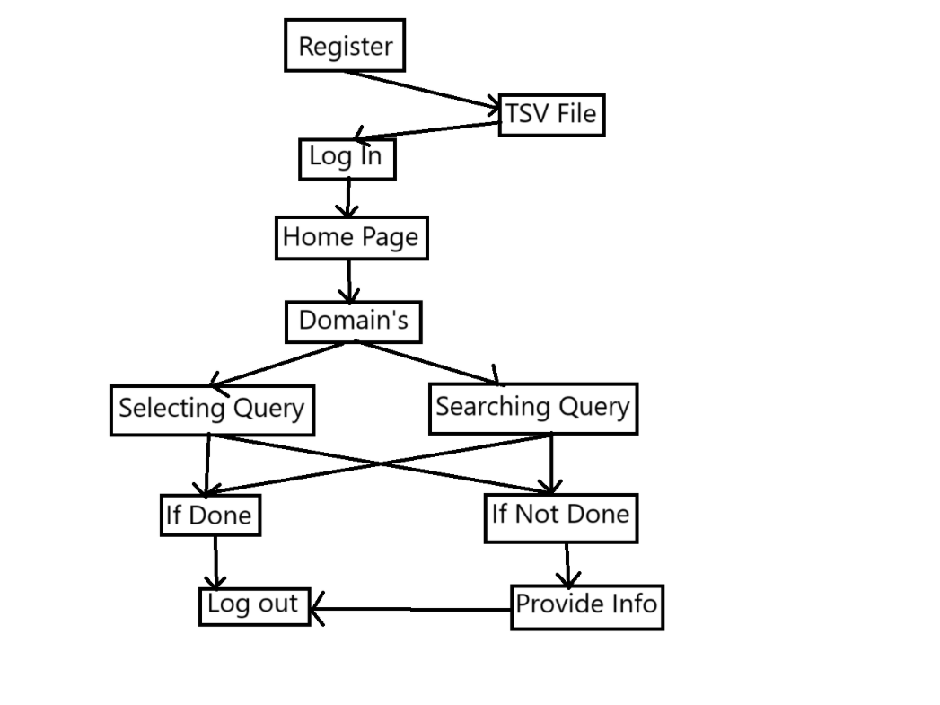
Architecture

Slide 12
Software components
Natural Language Processing (NLP): Figures out what the customer wants and how they feel about it.
Knowledge Base: A database that stores answers to common questions, troubleshooting guides, and product information. It can be simple (like a TSV file) or complex (like a full-featured database). It can also be connected to a system that tracks specific problems.
Search Engine: Searches the knowledge base for answers that match the question the customer asked.
Dialogue Management: Keeps the conversation going by asking follow-up questions, suggesting options, or sending the customer to a human if needed.
Learning Engine: Watches how the chatbot performs and improves its skills over time.

Slide 13
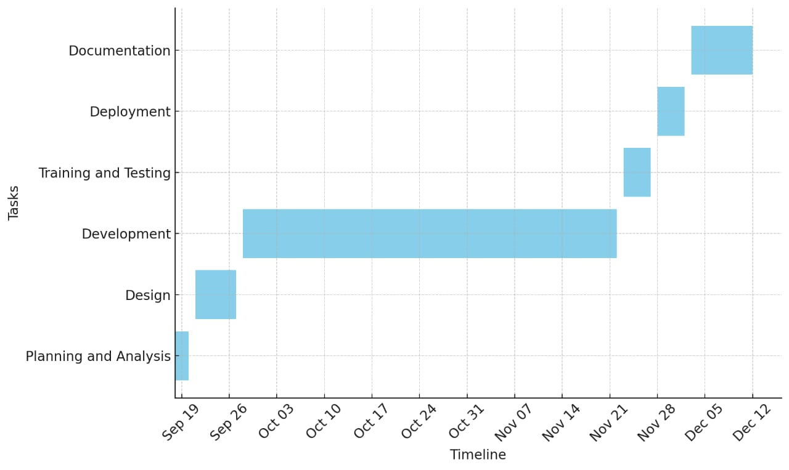
Timeline of Project

Slide 14
Implementation Details
1. Technologies Used:
Frontend: HTML, CSS, JavaScript for user interface.
Backend: Python with machine learning libraries.
2. System Architecture
User queries are processed through the interface, analyzed with ML algorithms, and responded to based on the identified context.
3. Workflow
Input through chatbot interface.
Preprocessing: tokenization.
Response generation and delivery.
4. Machine Learning Integration
Utilized labeled datasets for training.
Applied algorithms like logistic regression or neural networks.
Evaluated performance using accuracy, precision, and recall.

Slide 15
Implementation Details
5. Features
Supports shopping, booking, environment, and social media domains.
Provides dynamic query handling and context-aware responses.
6. System Challenges and Solutions
Addressed ambiguous queries with fallback responses.
Improved accuracy through domain-specific training.
7. Current Status
Fully functional chatbot ready for demonstration with interactive capabilities.

Slide 16
Expected Outcomes
Improved Customer Satisfaction: Quick and accurate responses enhance the overall customer experience.
Reduced Response Times: Automation decreases wait times for assistance.
Efficient Issue Resolution: Complex queries are escalated to human staff, ensuring timely resolutions.
Continuous Learning: The chatbot becomes more effective at handling queries through ongoing learning from interactions.
Enhanced Knowledge Base: The database is updated with new solutions, keeping information current.
Cost Savings: Automating support reduces operational costs related to staffing.
Increased Scalability: The chatbot can handle multiple queries simultaneously, allowing for scalable customer support.
Data-Driven Insights: Analysis of customer interactions provides valuable insights into behaviour and common issues.
24/7 Availability: Customers receive support at any time, improving accessibility.
Enhanced Employee Productivity: Human staff can focus on complex issues, increasing overall productivity.

Slide 17
Conclusion
To sum up, a customer care chatbot that possesses sophisticated abilities to comprehend inquiries, explore databases, and gain insight from human exchanges offers a revolutionary method of customer support.
It guarantees effective issue resolution while reducing client annoyance by skillfully managing ordinary enquiries and elevating complicated problems to support workers.
By continuously learning from interactions in real-time, the chatbot can answer similar questions on its own in the future, building a knowledge base that becomes better and better.
Furthermore, by handling several queries at once, the system improves scalability, lowers operating costs, and provides 24/7 customer service.
This technology streamlines internal operations and enhances the customer experience while freeing up human agents to work on more difficult jobs.
In the end, this kind of chatbot yields long-term advantages including increased output, more effective resource management, and steady company expansion.

Slide 18
Github Link
https://github.com/pavansreddy27/Customer-Support-Chat-bot-with-ML

Slide 19
References
KATRAGADDA, V. (2023). Automating Customer Support
Patel, N., & Trivedi, S. (2020). Leveraging predictive modeling, machine learning personalization, NLP customer support, and AI chatbots to increase customer loyalty.
Nuruzzaman, M., & Hussain, O. K. (2018, October). A survey on chatbot implementation in customer service industry through deep neural networks.
Nguyen, T. (2019). Potential effects of chatbot technology on customer support:
Abouelyazid, M. (2022). Natural Language Processing for Automated Customer Support in E-Commerce: Advanced Techniques for Intent Recognition and Response Generation.
D'silva, G. M., Thakare, S., More, S., & Kuriakose, J. (2017, February). Real world smart chatbot for customer care using a software as a service (SaaS) architecture.
Iyambo, H. N., & Iyawa, G. (2023). Customer Support Chatbot to Enhance Customer Support Experience Using Machine Learning Techniques.
Suta, P., Lan, X., Wu, B., Mongkolnam, P., & Chan, J. H. (2020). An overview of machine learning in chatbots. International Journal of Mechanical Engineering and Robotics Research, 9(4), 502-510.[8]
Kumar, R., & Ali, M. M. (2020).
Kumar, N. K., Maheswari, K., Abinaya, A., Ramya, J., Ande, P. K., & Ramaian, C. P. (2024, April). Advancements in Chatbot Technology for Enhanced Customer Support in Online Retail.

Slide 20
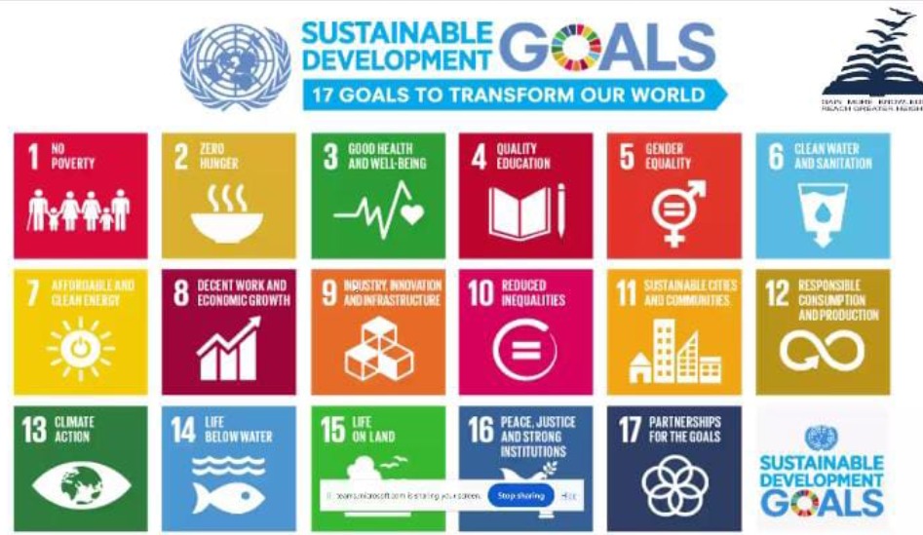
Project work mapping with SDG
As it encourages technological innovation
and enhanced service infrastructure:
Goal 8: Decent Work and Economic
Growth is especially relevant since
chatbots boost productivity and support
the expansion of businesses.
Goal 9: Industry, Innovation, and
Infrastructure is the SDG that
most closely corresponds with a
Customer Support Chatbot that
uses machine learning.

Slide 21
Thank You

